Slide 1



Pre Exposure Prophylaxis Campaign
by Davies Tsuro, Executive Director, My Voice in Zimbabwe

Slide 2
HIV EPIDEMIC GOALS 2025
INCIDENCE
DIAGNOSES
KNOWLEDGE OF STATUS
PREP COVERAGE
LINKAGE TO CARE
VIRAL SUPPRESSION
REDUCE NEW INFECTIONS BY 75% BY 2025
REDUCE NEW HIV DIAGNOSES BY 75% BY 2025
INCREASE THE PERCENTAGE OF PEOPLE WHO KNOW THEIR STATUS BY 95% BY 2025
INCREASE PREP COVERAGE TO 50% BY 2025
LINK 95% OF PEOPLE NEWLY DIAGNOSED WITH HIV TO CARE BY 2025
INCREASE VIRAL SUPPRESSION AMONG PEOPLE WITH DIAGNOSED HIV BY 95% BY 2925
GET PREP GO CAMPAIGN IS DESIGNED TO SENSITIZE, EMPOWER AND REFER YOUTHS FOR SERVICES OF PRE EXPOSURE PROPHYLAXIS AND HIV WITH A GOOD LINKING WITH SEXUAL REPRODUCTIVE HEALTH.

Slide 3
DEFINITION OF TERMS
FTC/TDF – emitrecitabine/tenofovir alafenamide
FTC/TAF – emitrecitabine/tenofovir disoproxil fumarate
MSM – Men who have sex with men
PEP- Post Exposure Prophylaxis
PrEP- Pre Exposure Prophylaxis
HBV- Hepetitis B Virus
FDA- Food and Drug Administration
GET PREP GO CAMPAIGN IS DESIGNED TO SENSITIZE, EMPOWER AND REFER YOUTHS FOR SERVICES OF PRE EXPOSURE PROPHYLAXIS AND HIV WITH A GOOD LINKING WITH SEXUAL REPRODUCTIVE HEALTH.

Slide 4
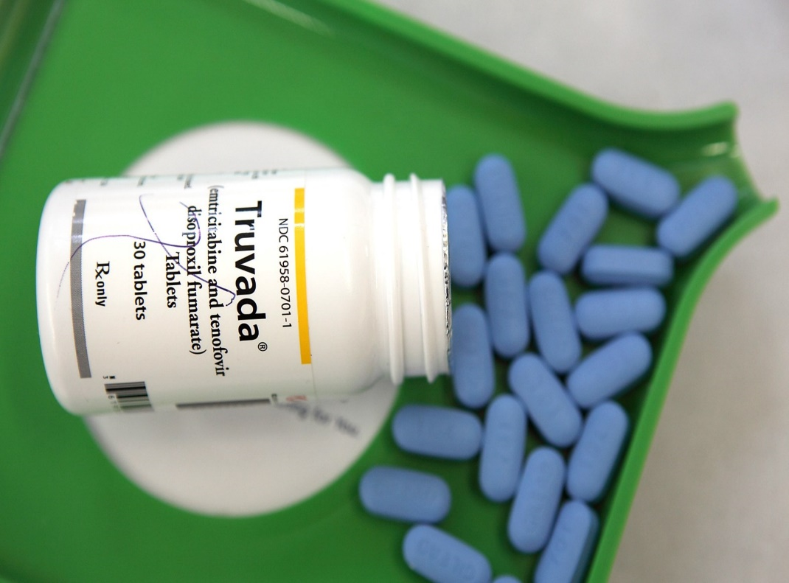
WHAT IS PREP?
Pre Exposure Prophylaxis (PrEP) is an antiretroviral drug given to an HIV negative person,
who engage in risky behaviors for HIV (Human Immunodeficiency Virus) and Its taken one pill per day (if it is Truvada or Descovy) or one injection per 2 months ( if it is Cabotegravir) to prevent from being infected with HIV.
GET PREP GO CAMPAIGN IS DESIGNED TO SENSITIZE, EMPOWER AND REFER YOUTHS FOR SERVICES OF PRE EXPOSURE PROPHYLAXIS AND HIV WITH A GOOD LINKING WITH SEXUAL REPRODUCTIVE HEALTH.

Slide 5
FDA APPROVED THERAPIES IN PREP
PEOPLE WITH RISKY BEHAVIORS THROUGH SEX:
MSM/TRANSGENDER WOMEN
CISGENDER WOMEN
FTC/TDF ( TRUVADA)
CABOTEGRAVIR (APRETUDE)
FTC/TDF ( TRUVADA)
FTC/TAF (DESCOVY)
CABOTEGRAVIR (APRETUDE)
GET PREP GO CAMPAIGN IS DESIGNED TO SENSITIZE, EMPOWER AND REFER YOUTHS FOR SERVICES OF PRE EXPOSURE PROPHYLAXIS AND HIV WITH A GOOD LINKING WITH SEXUAL REPRODUCTIVE HEALTH.

Slide 6
Side effects and toxicity of Truvada
Addition considerations
Nausea may occur with initiation typically resolve with time
Kidney injury occurs rarely so period monitoring is an obligatory and abnormalities always resolve with drug discontinuation
A small reversible decrease in bone mineral density may occur
PrEP does not prevent you from Sexual Transmitted Infections
It is effective in 7 days for anal receptive and in 21 days in vaginal receptive
GET PREP GO CAMPAIGN IS DESIGNED TO SENSITIZE, EMPOWER AND REFER YOUTHS FOR SERVICES OF PRE EXPOSURE PROPHYLAXIS AND HIV WITH A GOOD LINKING WITH SEXUAL REPRODUCTIVE HEALTH.

Slide 7
Who is a candidate for PrEP?
MSM
Women who inject drugs
Men who inject drugs
Heterosexual women
Heterosexual men
PrEP Candidates: SEXUAL HISTORY
Have you ever had a sexual transmitted infection?
Have you ever tested for HIV?
Do you have any of your sexual partner who has HIV?
How many sexual partners do you had in the past 1 month, 3 months or 6 months?
Do you have sex with men, women or both?
Do you use condoms and how often-(always, sometimes or never) and is it anal, vaginal or penile?
Have you ever been taken Post or Pre Exposure Prophylaxis?
GET PREP GO CAMPAIGN IS DESIGNED TO SENSITIZE, EMPOWER AND REFER YOUTHS FOR SERVICES OF PRE EXPOSURE PROPHYLAXIS AND HIV WITH A GOOD LINKING WITH SEXUAL REPRODUCTIVE HEALTH.

Slide 8
Who is a candidate for PrEP?
MSM
People who have an HIV positive sexual partners with a high viral load
People who inject drugs
Heterosexual women
Heterosexual men
PrEP Candidates: DRUG HISTORY
Have you ever used injection drugs?
Do you use methamphentamine or any other drugs?
Do you share injection equipment?
GET PREP GO CAMPAIGN IS DESIGNED TO SENSITIZE, EMPOWER AND REFER YOUTHS FOR SERVICES OF PRE EXPOSURE PROPHYLAXIS AND HIV WITH A GOOD LINKING WITH SEXUAL REPRODUCTIVE HEALTH.

Slide 9
Management of PrEP
ELIGIBILITY CRITERIA FOR PREP
A candidate should have a documented negative HIV result within 7 days before prescribed for PrEP
A candidate should have zero or no symptoms of acute HIV infection which are:
a tired feeling, Swollen lymph nodes (also called lymph glands), Swollen tonsils (also called tonsillitis), a sore throat, joint and muscle aches, diarrhea, a rash and a fever
GET PREP GO CAMPAIGN IS DESIGNED TO SENSITIZE, EMPOWER AND REFER YOUTHS FOR SERVICES OF PRE EXPOSURE PROPHYLAXIS AND HIV WITH A GOOD LINKING WITH SEXUAL REPRODUCTIVE HEALTH.

Slide 10
Tenofovir based PrEP visit schedule
SCREENING
INITIATION
Less than 7 days later
ONE MONTH VISIT:
Adherence
Side effects
Risk reduction
Counselling
Consider HIV test
First PrEP visit Screening:
Sexual history
Basic medical history, exam - Symptoms of acute HIV
PrEP basics, how it works, adherence, side effects.
Labs: HIV, STIs, Pregnancy
GET PREP GO CAMPAIGN IS DESIGNED TO SENSITIZE, EMPOWER AND REFER YOUTHS FOR SERVICES OF PRE EXPOSURE PROPHYLAXIS AND HIV WITH A GOOD LINKING WITH SEXUAL REPRODUCTIVE HEALTH.

Slide 11
Tenofovir based PrEP visit schedule
SCREENING
3 months
6 months
9 months
12 months
Follow up visits after every 3 months:
Symptom review: Acute HIV
Assessment counselling
Update of sexual history
Adherence
Labs: HIV, STIs, Pregnancy
90-day prescription, condoms
GET PREP GO CAMPAIGN IS DESIGNED TO SENSITIZE, EMPOWER AND REFER YOUTHS FOR SERVICES OF PRE EXPOSURE PROPHYLAXIS AND HIV WITH A GOOD LINKING WITH SEXUAL REPRODUCTIVE HEALTH.

Slide 12
Truvada vs Cabotegravir
How does Cabotegravir differ?
HIV RNA baseline for 1 month then every 2 months
Injection baseline for 1 month then every 2 months
For MSM, Sexual Transmitted Infection check baseline is for every 4 months
GET PREP GO CAMPAIGN IS DESIGNED TO SENSITIZE, EMPOWER AND REFER YOUTHS FOR SERVICES OF PRE EXPOSURE PROPHYLAXIS AND HIV WITH A GOOD LINKING WITH SEXUAL REPRODUCTIVE HEALTH.

Slide 13
Discounting PrEP
Positive HIV results
Acute HIV signs and symptoms
Changed life situation: lower HIV risk
CONSIDERATIONS:
Caution with HBV flares
If stop PrEP how long to take it beyond last high risk sexual encounter
- 4 weeks, by analogy to PEP
GET PREP GO CAMPAIGN IS DESIGNED TO SENSITIZE, EMPOWER AND REFER YOUTHS FOR SERVICES OF PRE EXPOSURE PROPHYLAXIS AND HIV WITH A GOOD LINKING WITH SEXUAL REPRODUCTIVE HEALTH.

Slide 14
What if:
There is no increased birth defects with TDF/FTC among women in antiretroviral pregnancy registry
Thought to be comparable with breast feeding
PREGNANCY
THERE IS A KIDNEY PROBLEM
Stop TDF/FTC
Substitute TAF/FTC or cabotegravir
THERE IS AN ADHERENCE PROBLEM
Practice medication adherence
Appointment adherence
GET PREP GO CAMPAIGN IS DESIGNED TO SENSITIZE, EMPOWER AND REFER YOUTHS FOR SERVICES OF PRE EXPOSURE PROPHYLAXIS AND HIV WITH A GOOD LINKING WITH SEXUAL REPRODUCTIVE HEALTH.

Slide 15
What if:
PrEP should be continued until the HIV infected partner has achieved a stable suppressed viral load
Consider adherence concerns in HIV infected partner
Ask about condomless sex with other partners
STEADY PARTER IS UNDETECTABLE
GET PREP GO CAMPAIGN IS DESIGNED TO SENSITIZE, EMPOWER AND REFER YOUTHS FOR SERVICES OF PRE EXPOSURE PROPHYLAXIS AND HIV WITH A GOOD LINKING WITH SEXUAL REPRODUCTIVE HEALTH.

Slide 16
What is PEP???
WHEN TO USE NON OCCUPATIONAL PEP (nPEP)
A candidate is evaluated rapidly for PEP when care is sought to be (less than) <72 hours after no occupational exposure that presents the substantial risk of HIV acquisition.
GET PREP GO CAMPAIGN IS DESIGNED TO SENSITIZE, EMPOWER AND REFER YOUTHS FOR SERVICES OF PRE EXPOSURE PROPHYLAXIS AND HIV WITH A GOOD LINKING WITH SEXUAL REPRODUCTIVE HEALTH.

Slide 17
Barriers of PrEP
Finding eligible clients
Protocol for initiation
HIV testing access
Discomfort taking sexual history or providing STI care
Time pressures
Community or family PrEP related stigma
Injection drug use
syringes
Medical assisted treatment
GET PREP GO CAMPAIGN IS DESIGNED TO SENSITIZE, EMPOWER AND REFER YOUTHS FOR SERVICES OF PRE EXPOSURE PROPHYLAXIS AND HIV WITH A GOOD LINKING WITH SEXUAL REPRODUCTIVE HEALTH.

Slide 18
The PrEP regimens as approved in National Guidelines
• OPERATIONAL AND SERVICE DELIVERY MANUAL FOR THE PREVENTION, CARE AND TREATMENT OF HIV IN ZIMBABWE
• WHO IMPLEMENTATION TOOL FOR PRE-EXPOSURE PROPHYLAXIS (PrEP) OF HIV INFECTION
GET PREP GO CAMPAIGN IS DESIGNED TO SENSITIZE, EMPOWER AND REFER YOUTHS FOR SERVICES OF PRE EXPOSURE PROPHYLAXIS AND HIV WITH A GOOD LINKING WITH SEXUAL REPRODUCTIVE HEALTH.

Slide 19
The long-acting injectable Cabotegravir News
• Zimbabwe is the first country in Africa to announce regulatory approval for long-acting injectable cabotegravir for HIV prevention. The Medicine Control Authority of Zimbabwe indicated that the product is safe, effective and good quality. MCAZ is confident that the injectable drug will benefit those who receive it.
GET PREP GO CAMPAIGN IS DESIGNED TO SENSITIZE, EMPOWER AND REFER YOUTHS FOR SERVICES OF PRE EXPOSURE PROPHYLAXIS AND HIV WITH A GOOD LINKING WITH SEXUAL REPRODUCTIVE HEALTH.

Slide 20
REFERENCE
https://www.who.int/news/item/28-07-2022-who-recommends-long-acting-cabotegravir-for-hiv-prevention
https://clinicalinfo.hiv.gov/en/drugs/cabotegravir-1/patient
https://www.unaids.org/en/resources/presscentre/pressreleaseandstatementarchive/2021/december/20211222_cabotegravir
https://www.prepwatch.org/resources/long-acting-injectable-cabotegravir-for-hiv-prevention-what-do-we-know-and-need-to-know-about-the-risks-and-consequences-of-cabotegravir-resistance/
"Apretude- cabotegravir kit". DailyMed. Retrieved 24 December 2021.
Chingono, Nyasha (20 October 2022). "Zimbabwe becomes first African nation to approve HIV prevention drug". The Guardian. Retrieved 21 October 2022.
"Adopted USANs" (PDF). American Medical Association. Retrieved 19 September 2014.
World Health Organization (2015). "International nonproprietary names for pharmaceutical substances (INN): recommended INN: list 73". WHO Drug Information. 29 (1): 70–1. hdl:10665/331088.
Ryan G (7 July 2020). "Injectable PrEP Is Even More Effective Than Daily Truvada". Poz. Retrieved 9 November 2020.
Ryan G (9 November 2020). "For Women, Injectable Cabotegravir Is More Effective Than Truvada as PrEP". Poz. Retrieved 9 November 2020.
OPERATIONAL AND SERVICE DELIVERY MANUAL FOR THE PREVENTION, CARE AND TREATMENT OF HIV IN ZIMBABWE
https://apps.who.int/iris/bitstream/handle/10665/279834/WHO-CDS-HIV-18.10-eng.pdf
GET PREP GO CAMPAIGN IS DESIGNED TO SENSITIZE, EMPOWER AND REFER YOUTHS FOR SERVICES OF PRE EXPOSURE PROPHYLAXIS AND HIV WITH A GOOD LINKING WITH SEXUAL REPRODUCTIVE HEALTH.

Slide 21
THANK YOU!!!!
African Proverb
The way a donkey express gratitude is by giving someone a bunch of kicks
An envious person requires no reason to practice envy. Its always good to save or invest for the future.
A deaf ear is followed by death and an ear that listens is followed by blessing
African Wisdom
GET PREP GO CAMPAIGN IS DESIGNED TO SENSITIZE, EMPOWER AND REFER YOUTHS FOR SERVICES OF PRE EXPOSURE PROPHYLAXIS AND HIV WITH A GOOD LINKING WITH SEXUAL REPRODUCTIVE HEALTH.

